Slide 2
SharePoint Framework Extensions Overview
Bijay Kumar Sahoo

Slide 3





Bijay Kumar Sahoo
Co-Founder TSInfo Technologies
SharePoint Lover
Blogger
Trainer, Speaker & Author
Founder SharePointSky.com & EnjoySharePoint.com
Love Driving
Fewlines4Biju@gmail.com
https://in.linkedin.com/in/fewlines4biju/
@Fewlines4Biju
https://www.facebook.com/fewlines4biju

Slide 4
Introduction
SPFx Application Customizer
SPFx Field Customizer
SPFx Listview Command Set
Conclusion

Slide 5
Introduction
SPFx Extension overview

Slide 6
SPFx Extension
Extend user experience with in modern pages & libraries
Customize notification areas, toolbars, and list data views

Slide 7
Types of SPFx Extensions
Application Customizers
Field Customizers
Command Sets

Slide 8
Application Customizer
Demo

Slide 9
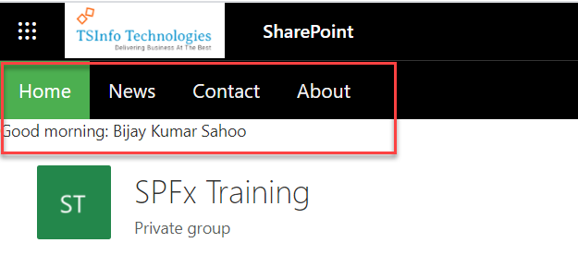
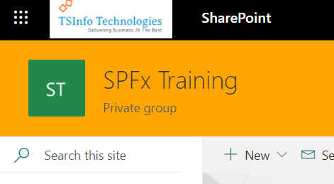
SPFx Application Customizer
By using SPFx application customizers, we can add scripts, access HTML element placeholders, and extend those placeholders.

Slide 10
Field Customizer
Demo

Slide 11
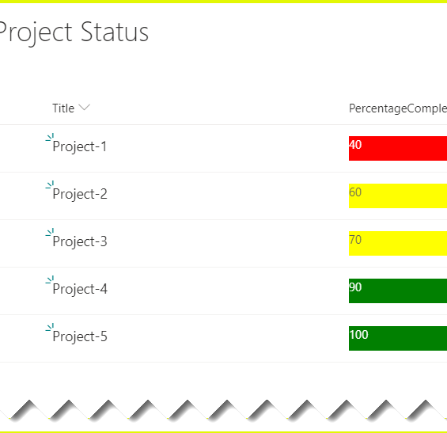
SPFx Field Customizer
By using SPFx field customizers we can modify the list views.
onInit(): The onInit() method get called after this.context and this.properties are assigned, but before the page DOM is ready.
onRenderCell(): onRenderCell() event triggered when each cell is rendered.
onDisposeCell(): onDisposeCell() is used to free up resources that were allocated while rendering.

Slide 12
Listview Command Set Customizer
Demo

Slide 13
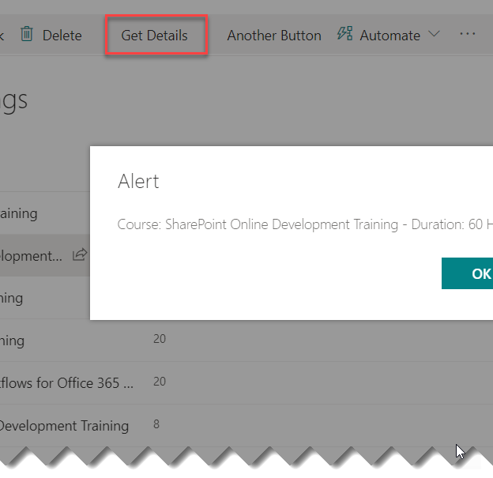
Listview Customizer Command Set
By using command sets, we can add new actions with client-side code to implement the behaviors.
onRenderCell(): onRenderCell() event triggered when each cell is rendered. Here we can use the event.domElement HTML element to extend our functionality.

Slide 15
Office UI Fabric with SPFx
By Harsha Vardhini

